Slide 1
Analyzing Risk Communication During COVID-19 Pandemic
IT 7993 Capstone Project
Kennesaw State University College of Computing and Software Engineering
Dr. Shirley Tian, Project Owner
Dr. Meng Han, Advisor
Elaine Harris, Team Leader
Michael Farris
Maryline Kwa
Sang Nguyen
Gabriel Oyebanji
Raviteja Pasumarthi
Chelsey West

Slide 2


Project Overview
This research project seeks to assess and analyze the relationship between public health advisory statements during the COVID-19 Pandemic and the trends on new infections in Singapore. We are interested in the following questions:
Is social media an effective way to communicate mitigation strategies?
Is there a correlation between public health messaging and confirmed positivity rates?
Are there downward trends in daily COVID-19 positivity rates when mitigation mandates are issued?

Slide 3







Our Team
Elaine Harris
Team Leader
Data Analytics
Michael Farris
Data Extraction & Visualization
Sang Nguyen
Project Presentations
Maryline Kwa
Data Extraction & Analytics
Gabriel Oyebanji
Data Extraction
Chelsey West
Technical Writer
Raviteja Pasumarthi
Data Extraction

Slide 4
Methodology Overview
Data is collected from the Singapore Ministry of Health’s official Facebook page and Twitter feed.
The cleaned data will be combined with COVID-19 daily case count data provided by the World Health Organization (WHO).
The data will be analyzed to for correlations between official messaging about the Pandemic and daily case increases and decreases.
Data Extraction
Data Cleaning
Data Analysis
Data Visualization

Slide 5
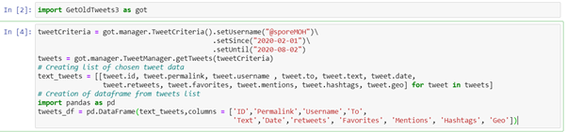
Twitter Data Extract
Data has been collected from Twitter posts from the Singapore Ministry of Health (@sporMOH) between 02/01/2020 and 08/01/2020
Open source Python product used to extract historical data: https://github.com/Jefferson-Henrique/GetOldTweets-python
Twitter Raw Data File
Data import code using GetOldTweets3

Slide 6
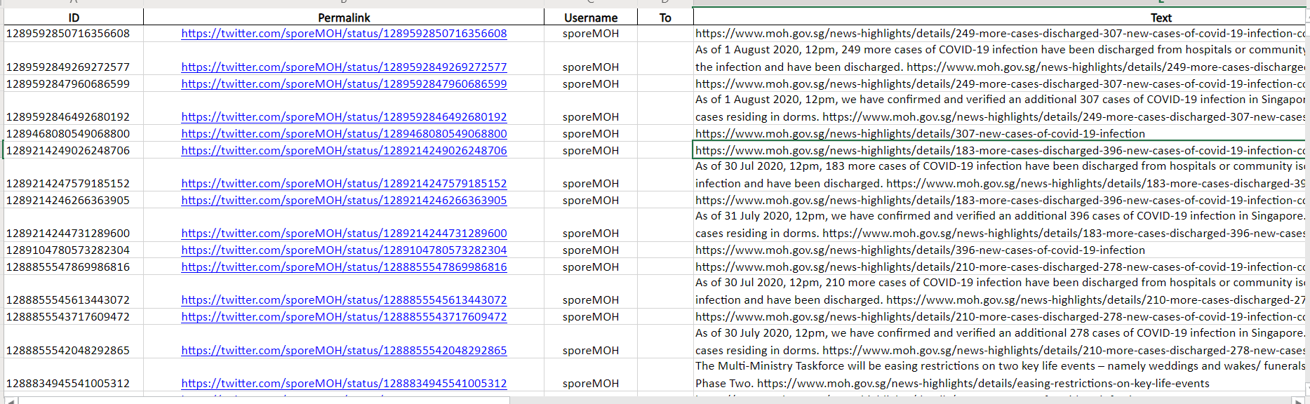
Twitter Extract Output

Slide 7
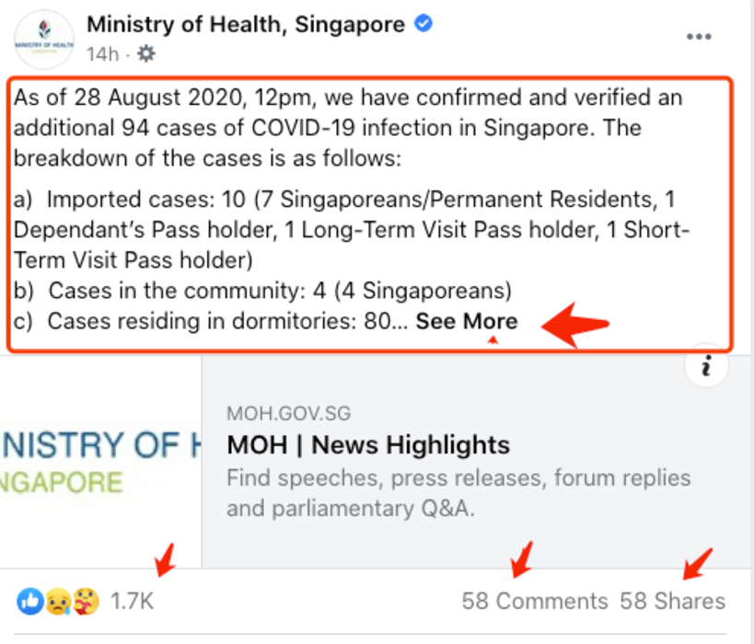
Facebook Data Extract
Facebook does not provide free good API’s for data extraction.
Facebook data obtained by screen scraping the following fields from the Facebook posts: date, post (text), No. of likes, No. of comments, and No. of shares.
Captured data is saved in multiple Excel files, one for each team member involved in the collection process.
Facebook Raw Data File

Slide 8
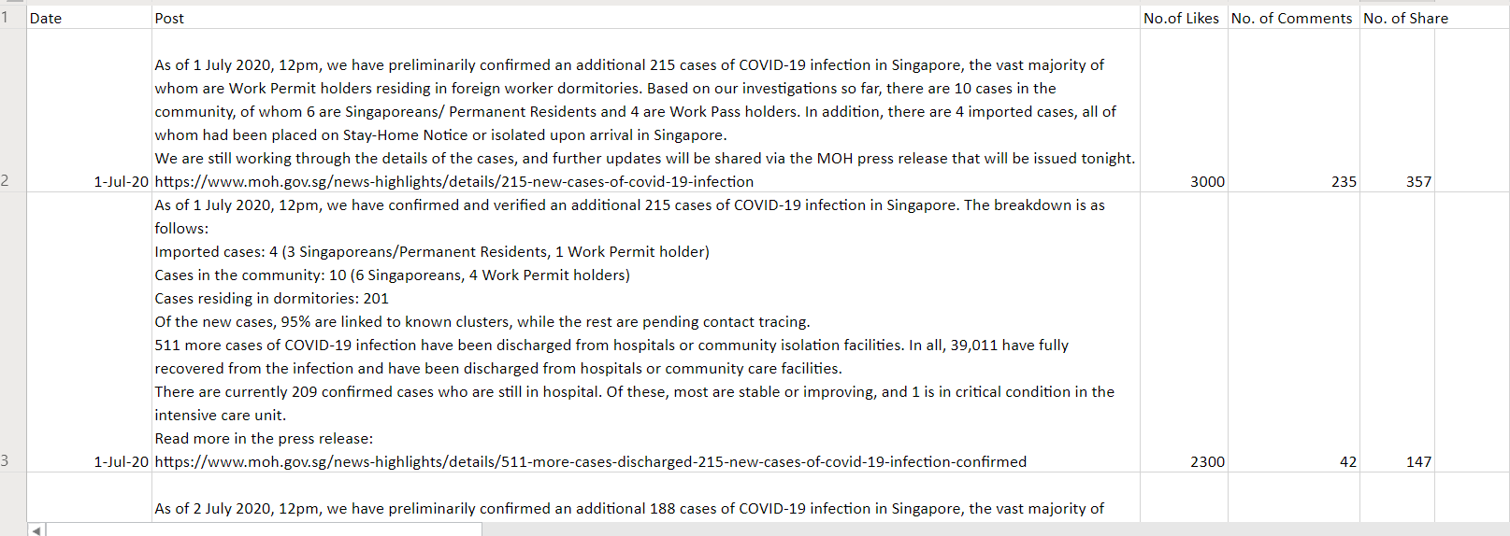
Facebook Data Output

Slide 9
Topic Modeling
Machine Learning Algorithms

Slide 10
Why Topic Modeling?
To answer the questions:
1) “What are they talking about?”
We don’t know the topics before we start the analysis
Social Media posts are human-readable text: we need to infer topic and intent
2) “How much do they talk about it?”
How frequently do they talk about each topic? What topics are most emphasized?
We need to classify pure text into DISCRETE CATEGORIES for Statistical Analysis
Data Visualization tools also need discrete categories for plotting graphs and charts

Slide 11
Topic Modeling vs Text Classification
Both are techniques to identify topics as categories in a collection of texts.
Topic Modeling is an Unsupervised Machine Learning technique used to read the text and identify topics based on keywords frequency without human intervention.
Latent Dirichlet Allocation (LDA) with Gensim Library for Python.
Text Multiclass Classification is a Supervised Classification Algorithm and requires a priori knowledge of the categories and manual labeling of a training set.
Multiclass LSTM (Long Short Term Memory) Classifier with Keras Library for Deep Learning in Python
Latent Dirichlet Allocation (LDA)
Deep Learning LSTM CLASSIFIER
LDA assumes documents are produced from a mixture of topics. The algorithm calculates topics based on word frequency and how important a word is to define a topic: TFIDF (Term Frequency-Inverse Document Frequency)
First, the algorithm detects a set of topics across all documents. Each topic consists of a set of words selected based on the calculated probability of those words appearing together. In a large corpus, the top x words are selected to represent a topic.
Second, the algorithm evaluates each document (in our case, each post is a document) against the list of topics. A probability distribution is calculated that results in a match score to each topic.
Finally, a Dominant Topic is assigned to each post: topic with highest probability match.
Supervised Classification algorithms require a ‘training’ set tagged with representative categories. Once the model is trained, it is used to predict categories on unseen data, or ‘testing’ data.
We chose the categories based on topics suggested by the LDA model.
The model is trained on the ‘training’ data, and validated using a classic 80-20 stratified shuffle split, so all categories are included.
A Deep Learning Model is trained in cycles, or ‘epochs’. The more epochs, the more accurate the model will be, until it reaches a point when additional training does not produce improved learning. We trained with 20 epochs.

Slide 12
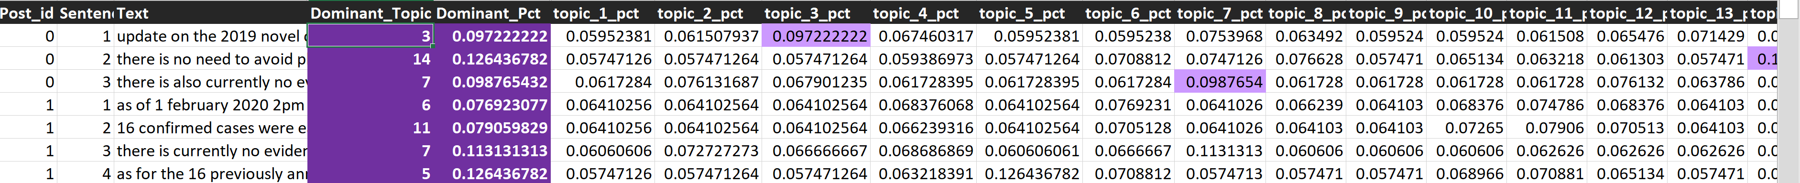
LDA Algorithm Output
Model produced 15 topics.
Each text is assigned a probability distribution for all 15 topics.
A Dominant Topic is chosen based on the highest probability match.
Problem: for many posts, all probability values are low, and even the Dominant Topic does not represent a clear classification.

Slide 13
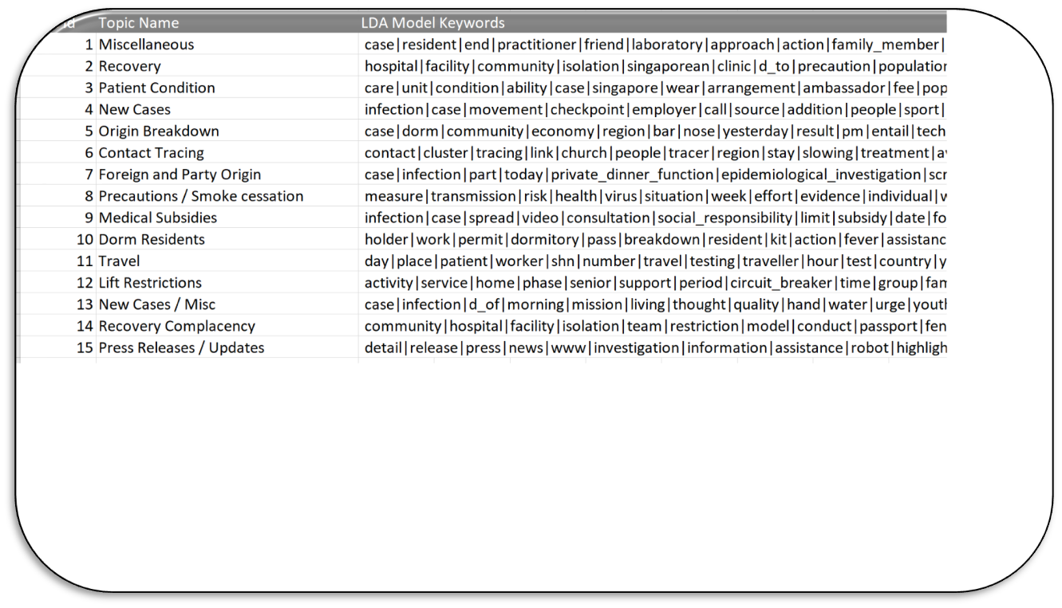
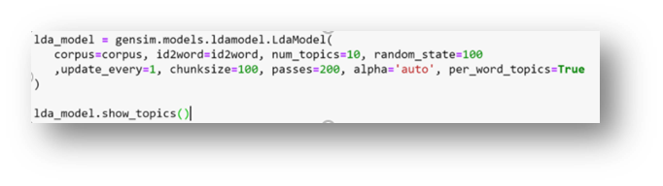
LDA Topics
Generated LDA Topics are a list of words that require human interpretation:
Some topics overlap, others are simply unclear.

Slide 14
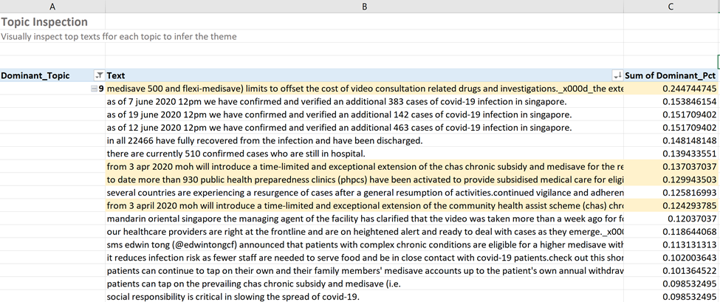
LDA Modeling Additional Constraints
For example, this is the return for the topic ‘Medical Subsidies’
Highlighted items match topic description
Also collects multiple postings that do not match
LDA method produced many postings with low probability match to the Dominant Topic, making categories unclear.

Slide 15
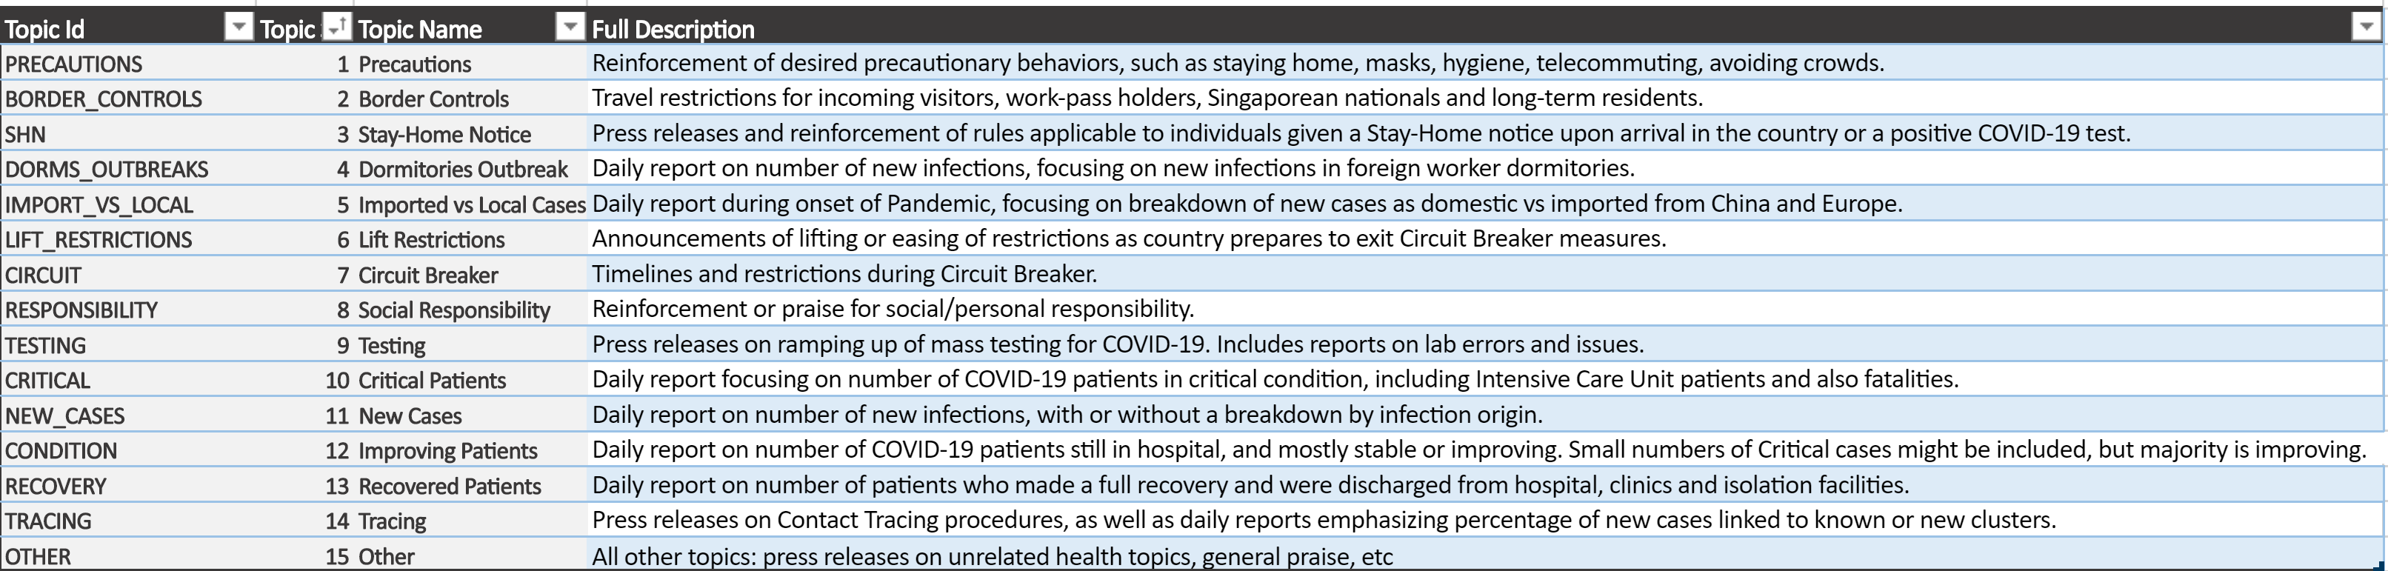
Multiclass Labeling of LDA Topics
In order to better categorize our data, additional analysis was completed using Deep Learning Multiclass Classification LSTM Model.
During this process, the previously identified categories from the LDA modeling are refined and ranked from most to least interesting.

Slide 16
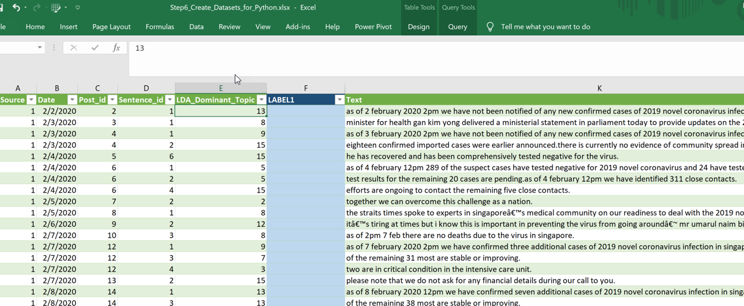
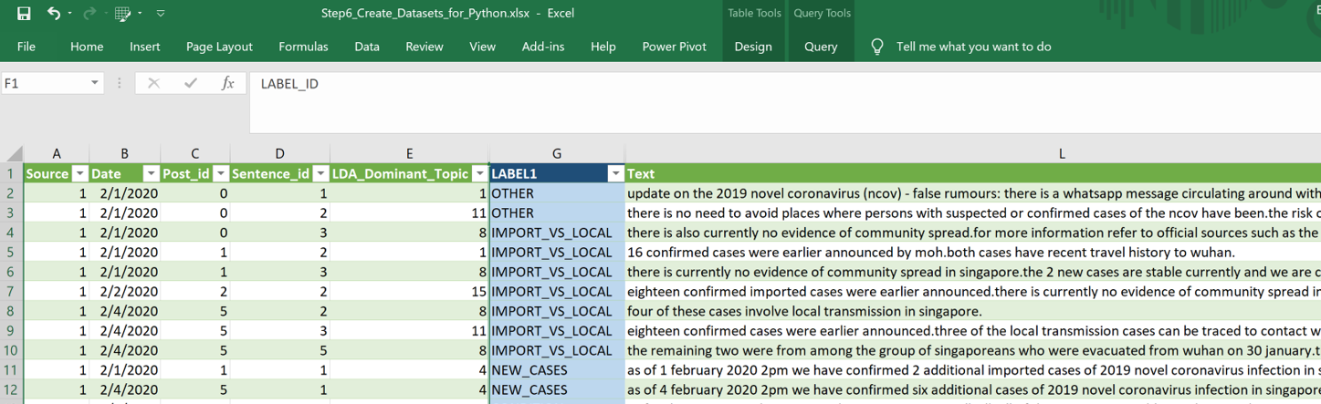
Labeled & Unlabeled Data Sets
The posts within those categories are split into ‘testing’ and ‘training’ data; manually labeled data in the training set, and unlabeled data in the testing set.
The labeled data set is used to train our model, the unlabeled data set is then run through the model for classification.

Slide 17
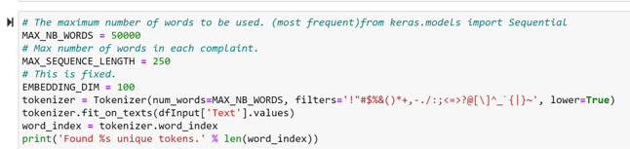
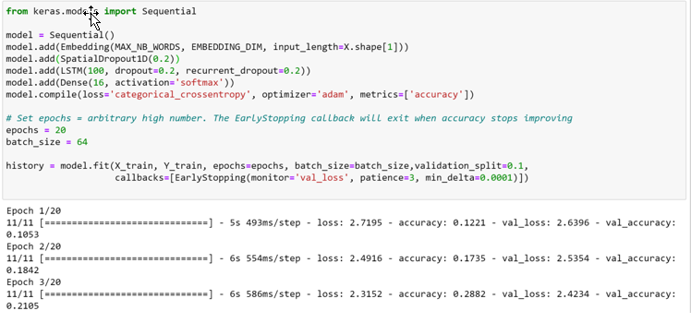
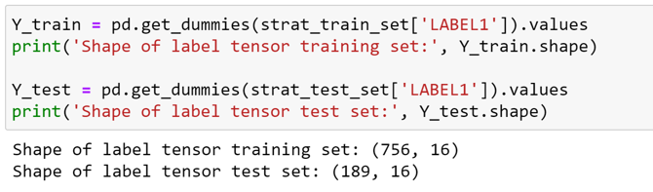
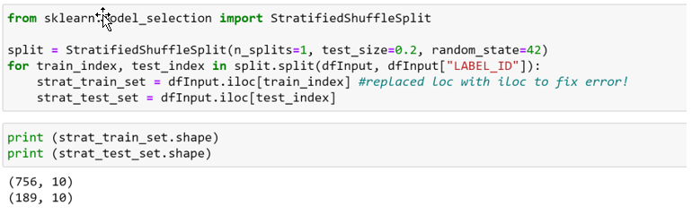
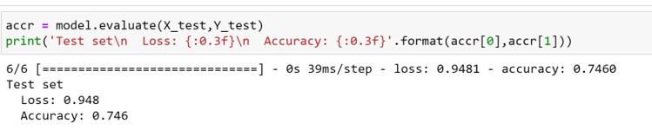
Python/Jupyter Notebook
#1
#4
#2
#3
#5

Slide 18
Findings
SUPPORTING EVIDENCE FOR OUR PROJECT QUESTIONS

Slide 19
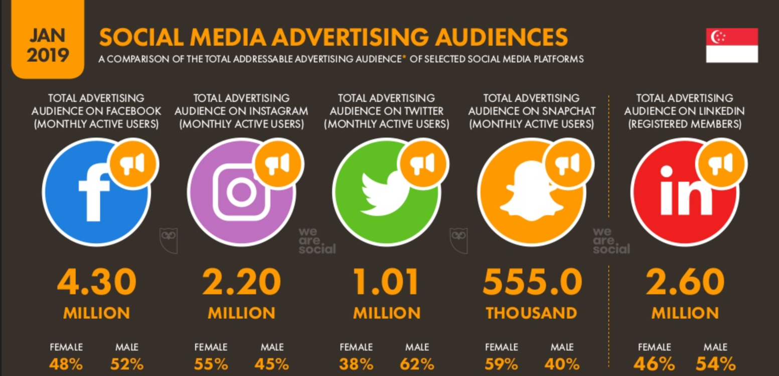
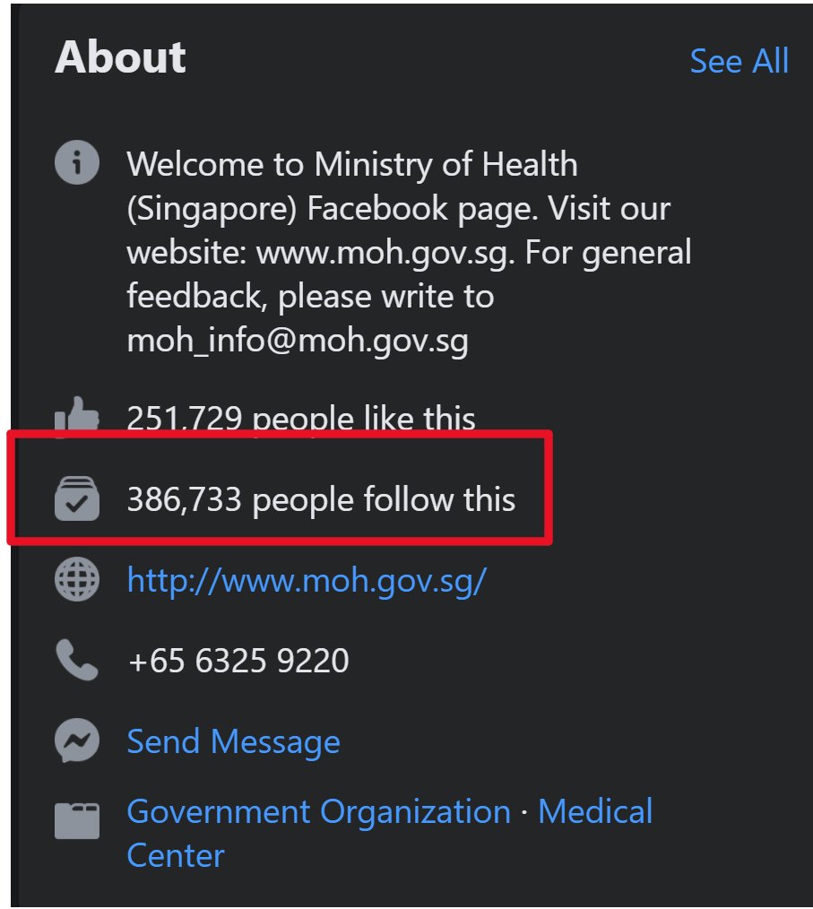

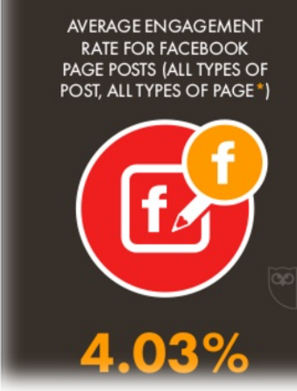
Is social media an effective way to communicate mitigation strategies?
Frequency Analysis executed in Excel
Boxplots created in SPSS
What is the reach of a specific Social Media site?
What are the most popular topics chosen by Government officials?
What topics does the public find most interesting?
Engagement for total Facebook market: 4.03% x 4.3 million = 173k =
2.96% of population
Engagement for MOH page followers: 4.03% x 386.7K = 15.5k =
0.27% of population

Slide 20
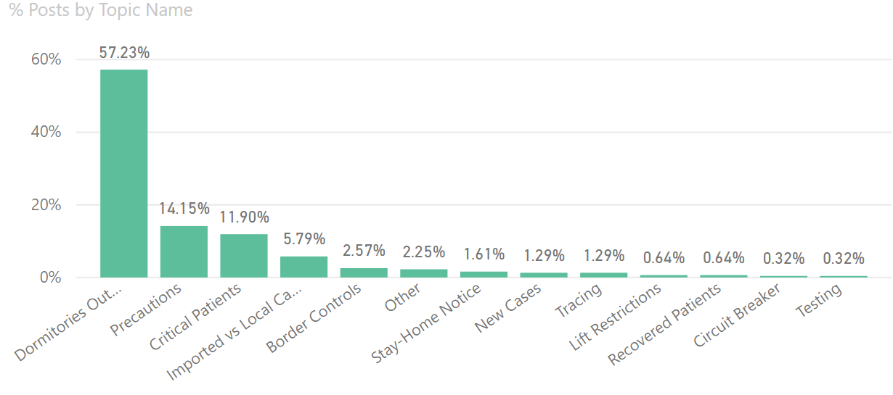
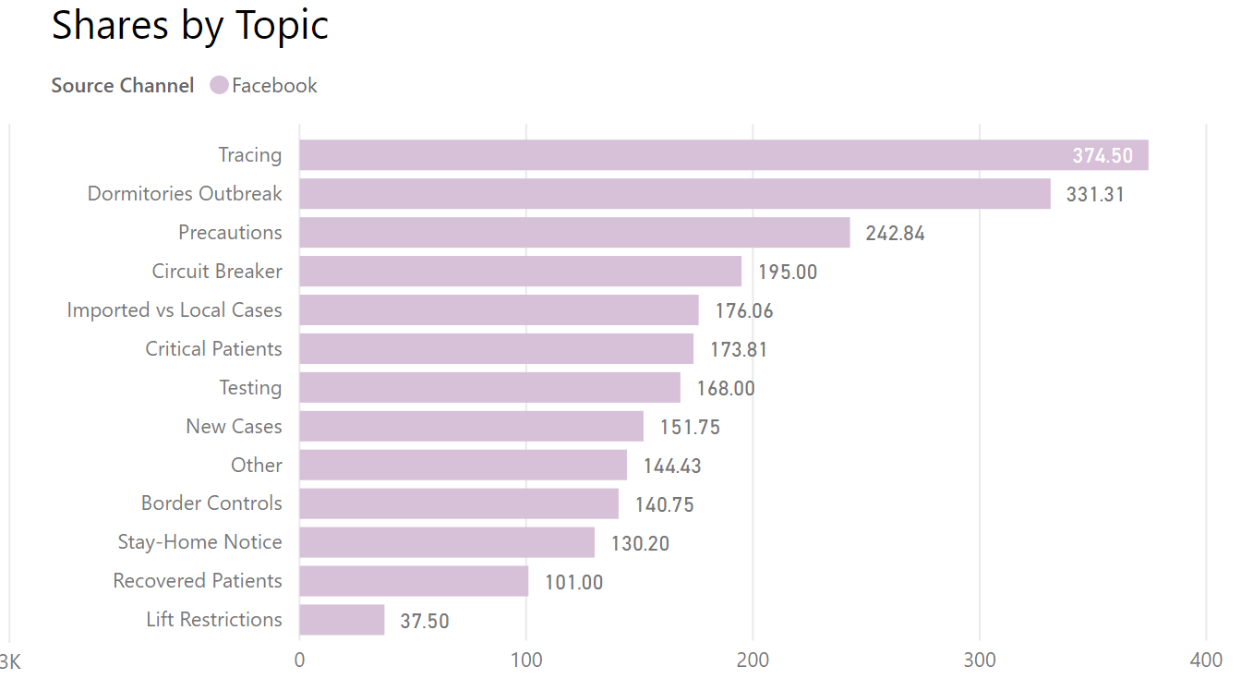
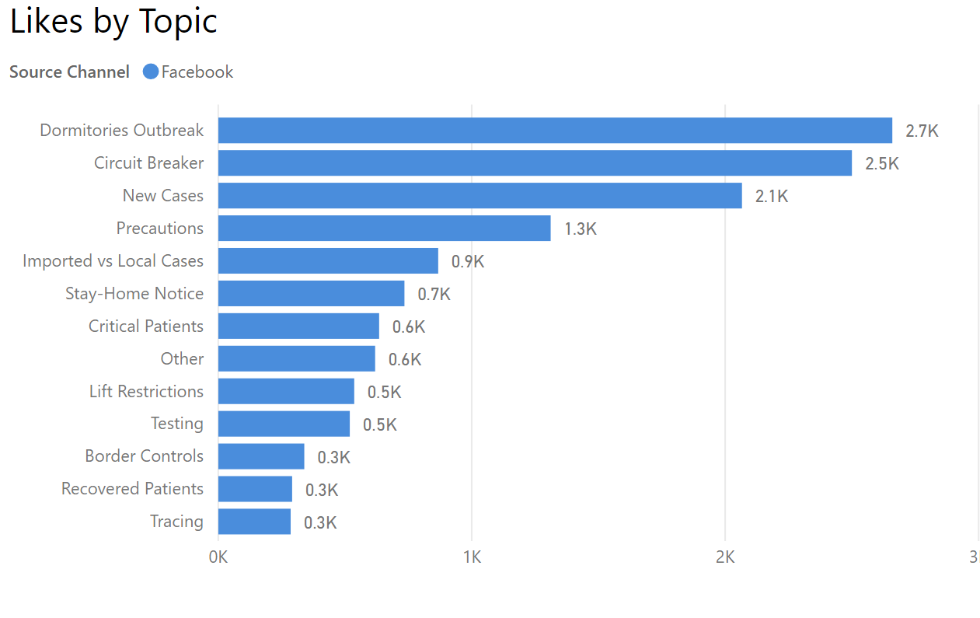
Topics vs. User Average Response - Facebook
How did users respond to government topic choices?
The most frequent topic posted in Facebook is Dorms Outbreaks, which is also the second most shared topic.
The average number of Likes is consistently higher than the average number of Shares, at a 14:1 ratio.

Slide 21
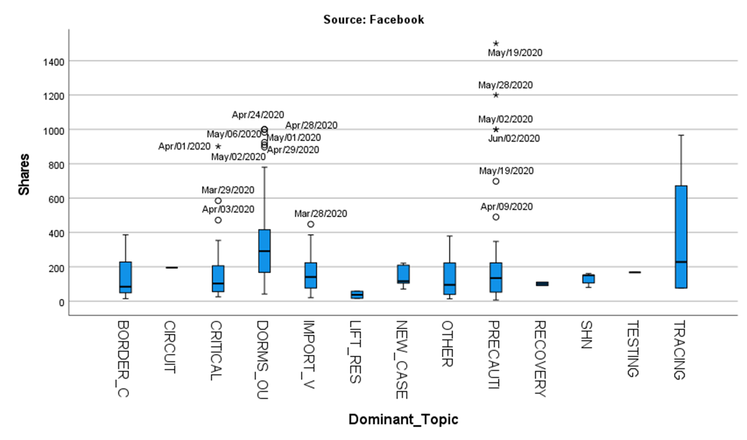
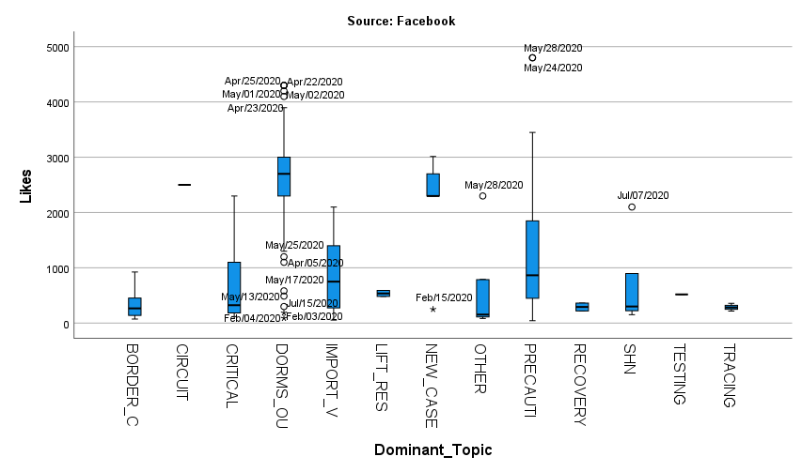
Boxplot and Outliers
Facebook
Facebook peaks public interest on 05/19 with 1,500 Shares: Announcement of end of Circuit Breaker restrictions. Topic: Precautions.
Facebook gets the most Likes on 05/28 at 4,800 Likes, topic Precautions: post confirms exit of circuit Breaker starting on June 1.
Facebook users interest peaks at imminent changes to daily life restrictions.
On a daily basis, interest stems from follow up on sources of new infections (Dorm Outbreaks and Tracing strategies)

Slide 22
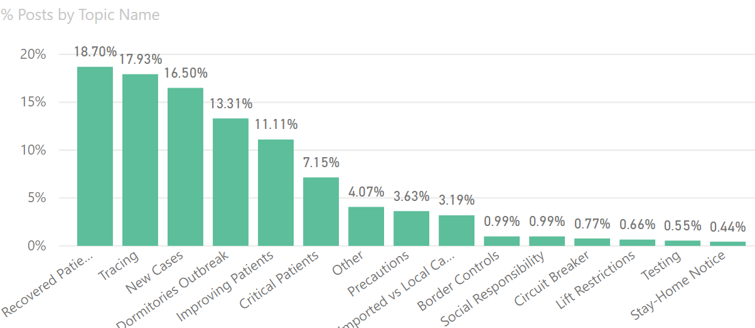
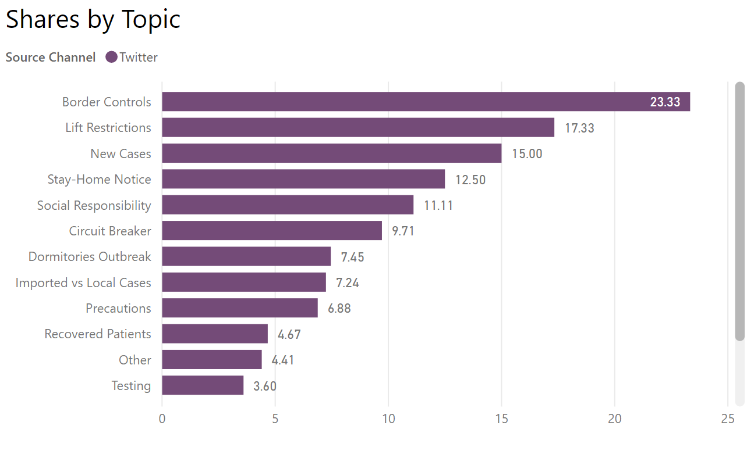
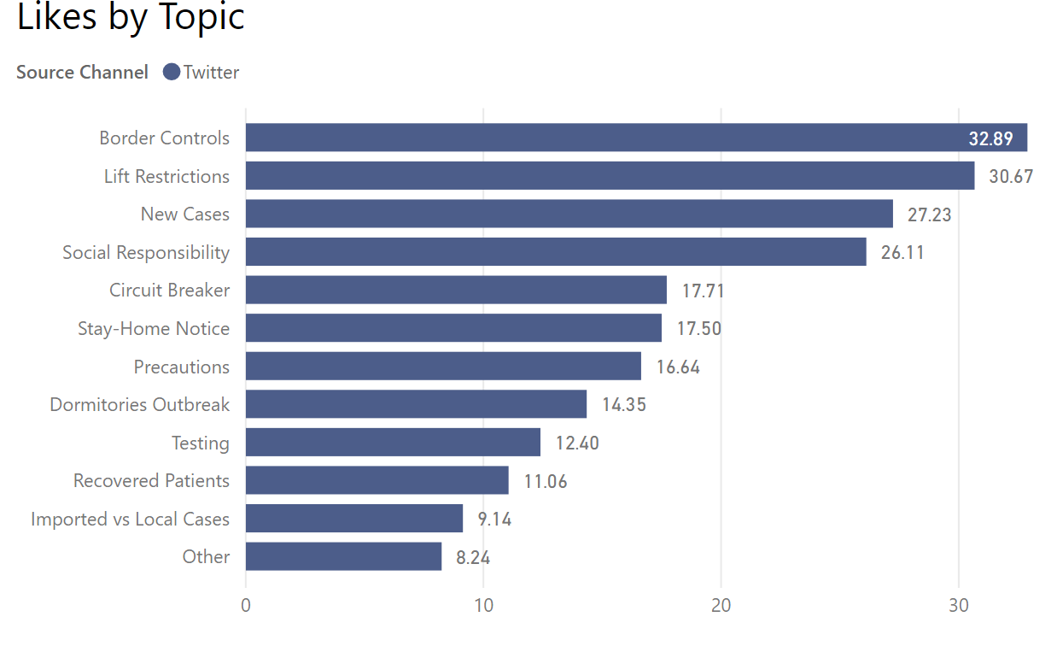
Topics vs. User Average Response - Twitter
How did users respond to government topic choices?
Twitter posts are more granular, with a more even distribution of the top 5 topics.
The ratio of Likes to Shares is not as extreme as Facebook, at roughly 2:1
In general, the volume of Likes and Shares in Twitter is too low to warrant further analysis.

Slide 23
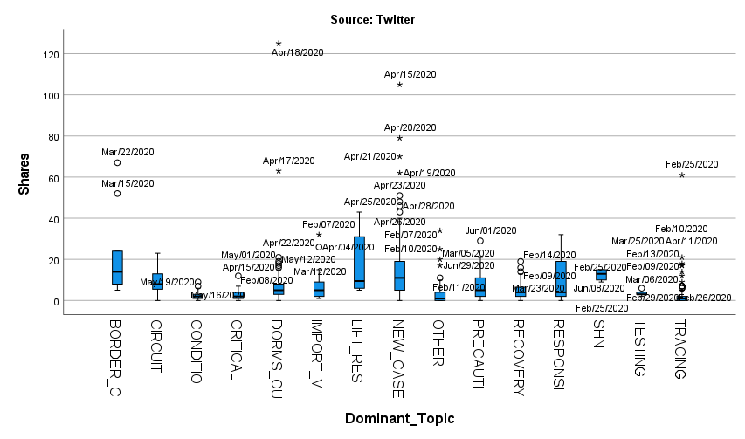
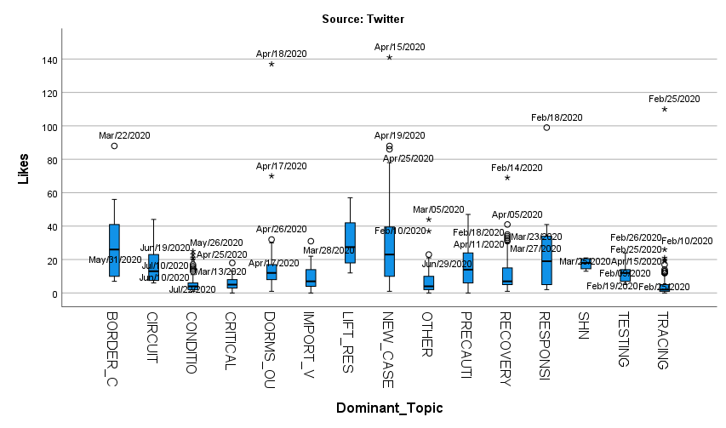
Topics vs. User Response
Twitter
Twitter peaks public interest on 04/18 with 125 Shares, topic Dorms Outbreak.
Twitter Likes peak on the same days as Twitter Shares: 04/15 and 04/18.
Twitter peaks public interest on 04/18, at 141 Likes, topic Dorms Outbreak: as of 18 apr 2020 12pm we have preliminarily confirmed an additional 942 cases of covid-19 infection in singapore the vast majority of whom are work permit holders residing in foreign worker dormitories.
Twitter user interest appears to stem from the doubling of the number of confirmed cases over a period of 3 days.
Lifting Restrictions and Border Controls get some higher attention. Overall, response levels are too low to analyze (under 40 Likes or Shares)

Slide 24
Is there a correlation between public health messaging and confirmed positivity rates?
Pearson Correlation calculated in SPSS
Compared monthly frequency by topic to new cases daily average and new cases after 14 days
Compared monthly frequency for each educational behavior to new cases daily average and new cases after 14 days
Correlation is not causation!
Why do officials choose to increase or decrease the number of posts on specific topics?
Are changes in topic frequency correlated to the trends in new infections?

Slide 25
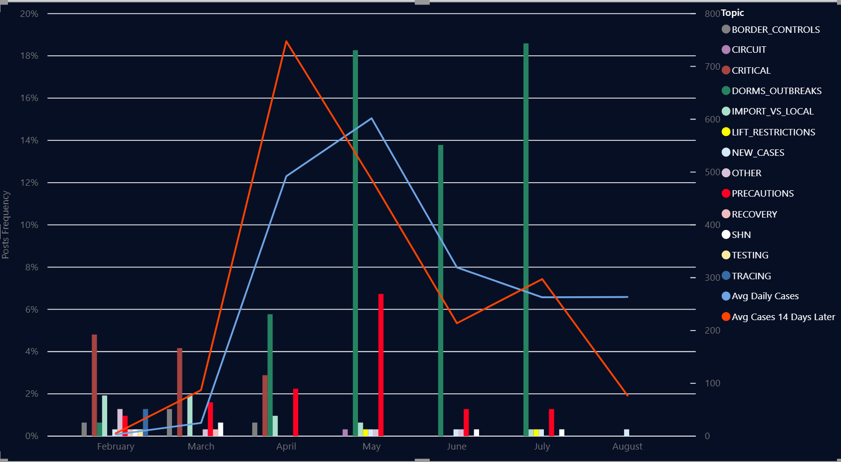
Topics vs. Case Trends – Facebook Posts
No strong correlations (>= 0.70) between any of the topics frequency and the average number of infections after 14 days.
The software found two strong correlations between Avg Daily Cases and Precautions (R = 0.712) and Lifting Restrictions (0.70).
These correlations likely indicate that the MOH officials increase the frequency of Precautions messages as the cases are climbing and decrease them as infections rates drop.
Most emphasized topic is Dorm Outbreaks. Despite the correlation, Precautions and Lift Restrictions frequencies are too low to draw any conclusions.

Slide 26
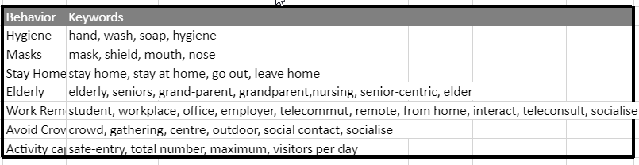
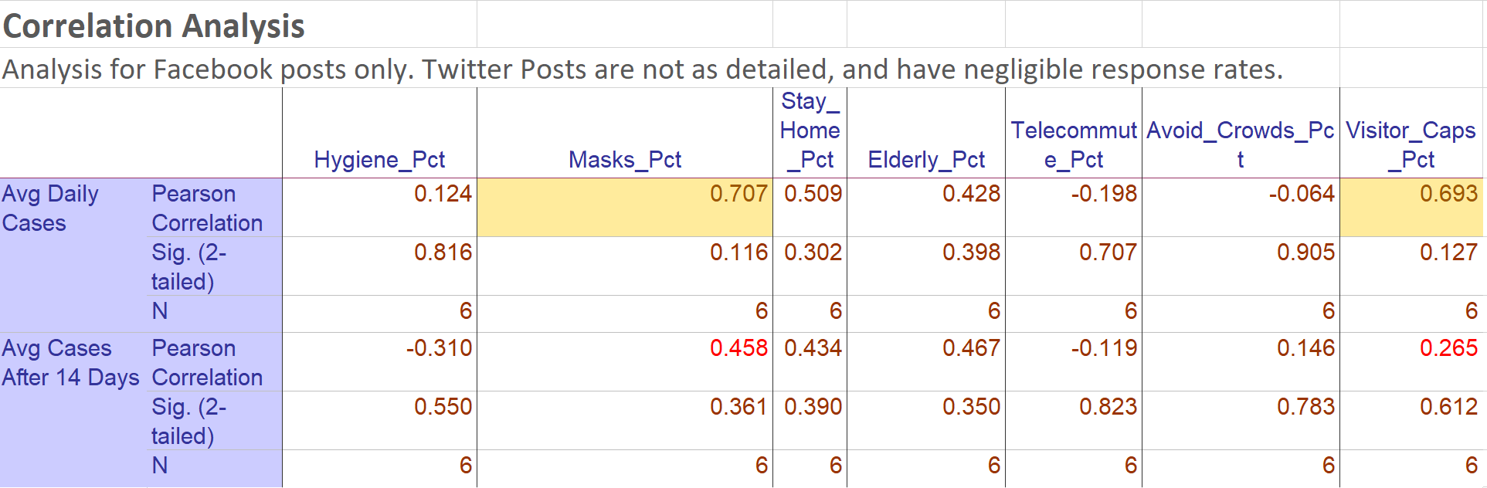
Beyond Topics - Behaviors vs. Case Trends
The precautions topic contains multiple behaviors that are either encouraged or discouraged in the social media posts. These were identified by keyword match on all posts and correlation analysis was completed.
There is one strong correlation (>= 0.70) between average daily cases and mask messages (R = 0.707).

Slide 27
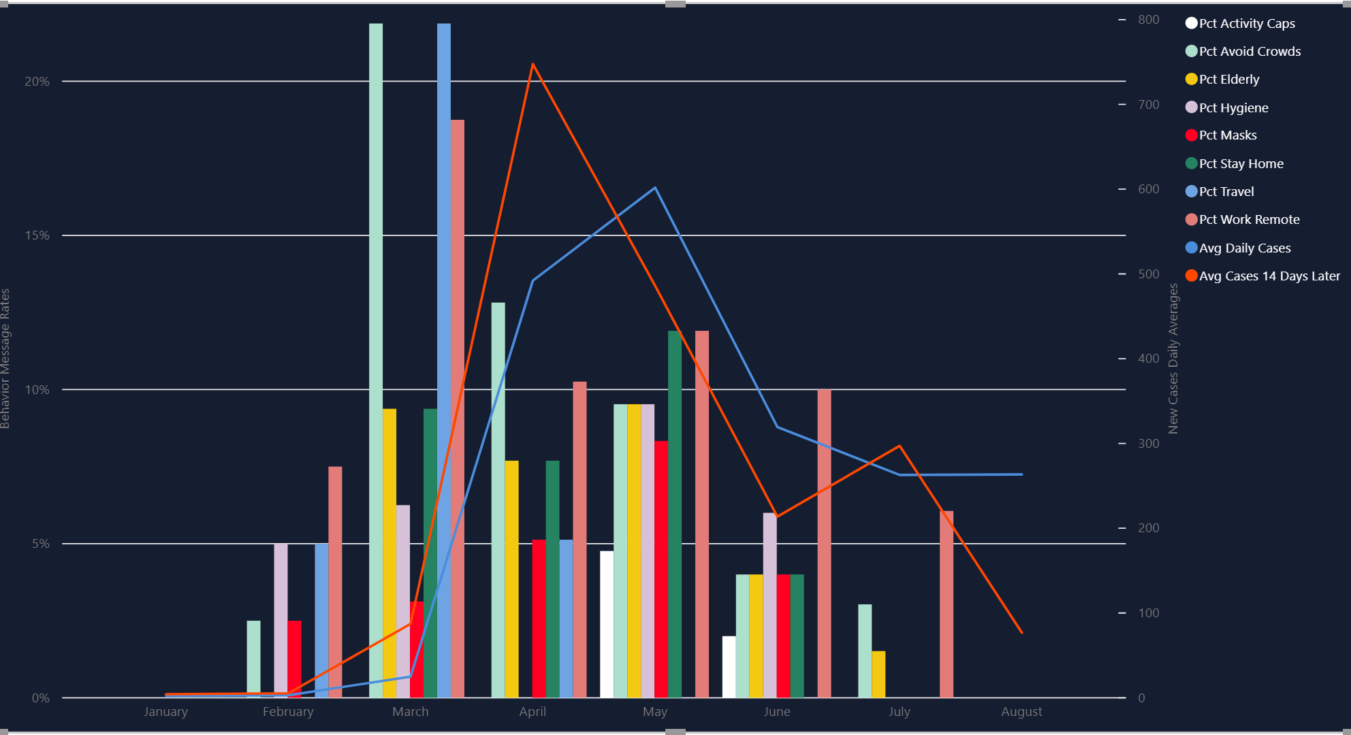
Beyond Topics - Behaviors vs. Case Trends – Facebook
Emphasis on hygiene and masks usage ranged between 2.5% to 9.52%.
The MOH places greater emphasis on Telecommuting and Avoiding Crowds. Both messages peak in March (Telecommute 18.75%, Avoid Crowds 21.88%).
Travel messages peak in March, as Travel Advisories go into effect.
Message content follows infection trends, but clearly there are ups and downs in the trends.
What government ACTIONS could explain changes in infection trends?

Slide 28
Timeline Analysis
Are there downward trends in daily COVID-19 positivity rates when mitigation mandates are issued?
Analysis of the timeline of announcements of government-mandated restrictions and how they relate to new infection trends.
In late March several travel restrictions are put in place, which in effect reduced the number of air travel arrival and departure passengers in April and May to less than 1% of the monthly average for 2019.
Travel restrictions include Travel Advisories for Singapore residents, mandatory 14-day isolation for arriving residents, prohibition of entry and transit of short-term visitors.
In early April elevated Social Distancing mandates are enacted (04/03). Masks in public are mandated by 04/15, while cases are still increasing sharply.
By early May we can see the first significant drops in new infections (about 2 weeks after Masks mandate, and 4 weeks after start of Circuit Breaker measures).
New infections continue to trend down during May, and Circuit Breaker restrictions are eased or lifted by Jun 01.

Slide 29
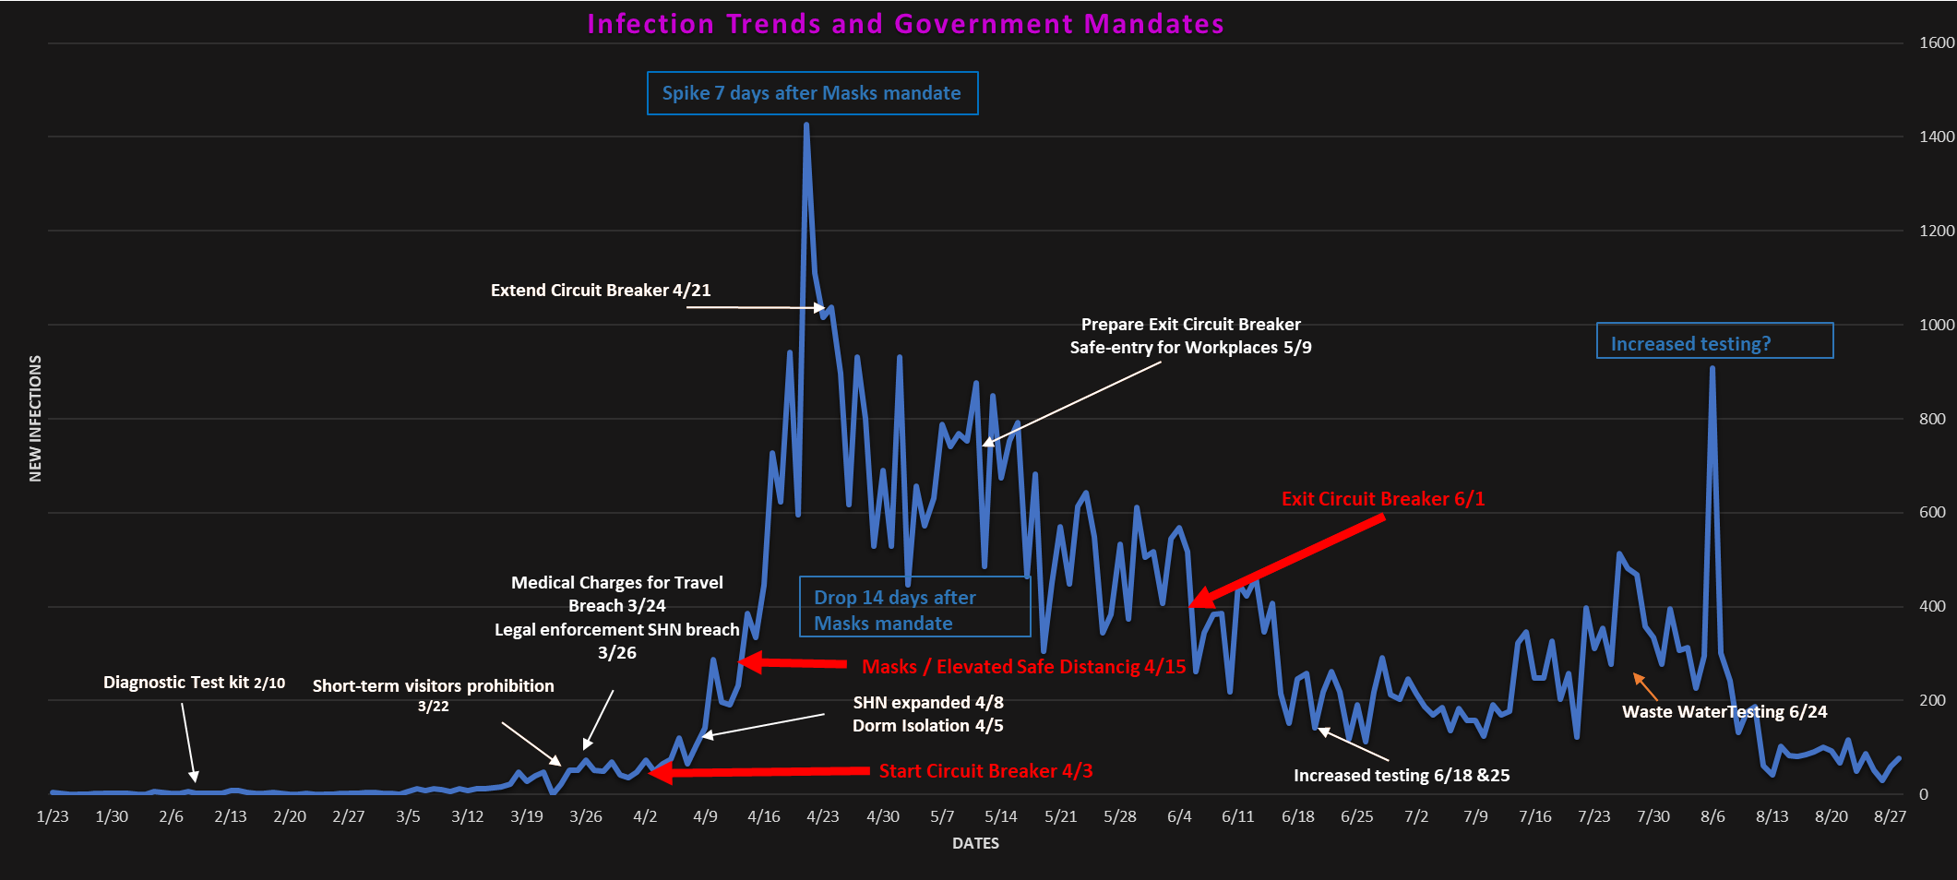
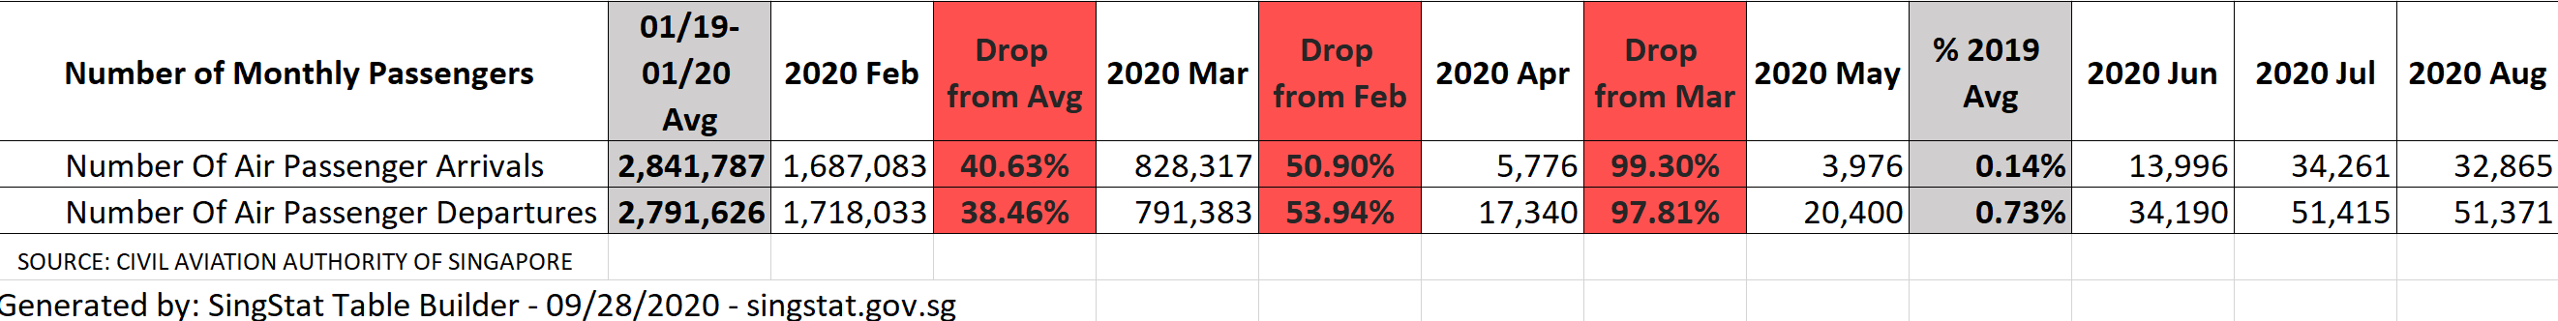


Slide 30
Data Visualizations
Power BI

Slide 31
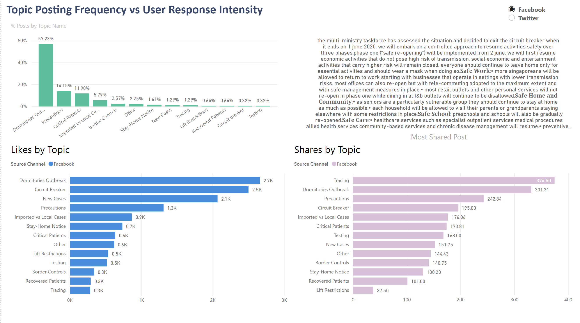

Slide 32
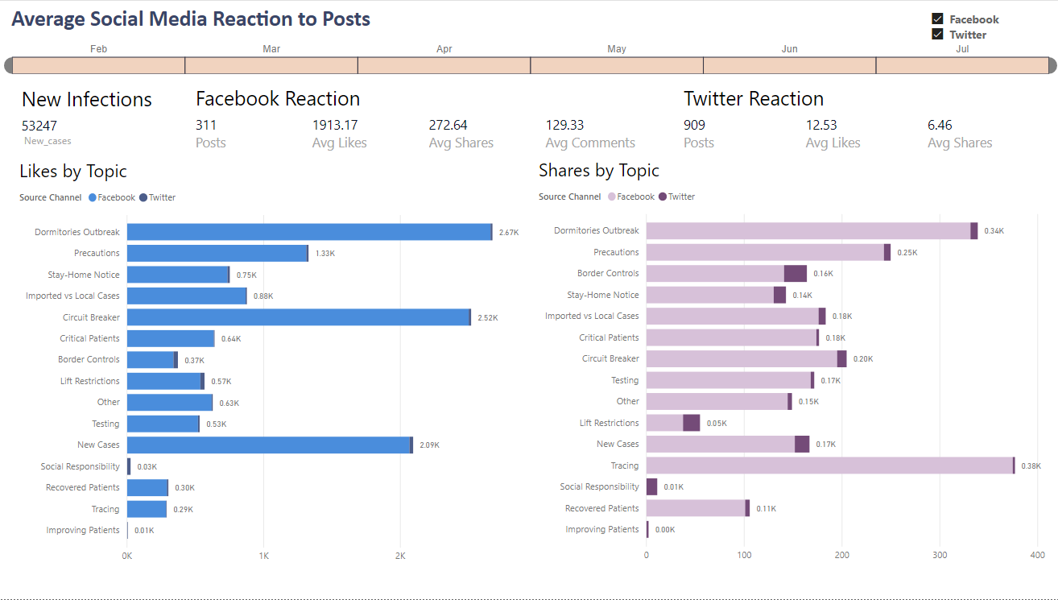

Slide 33
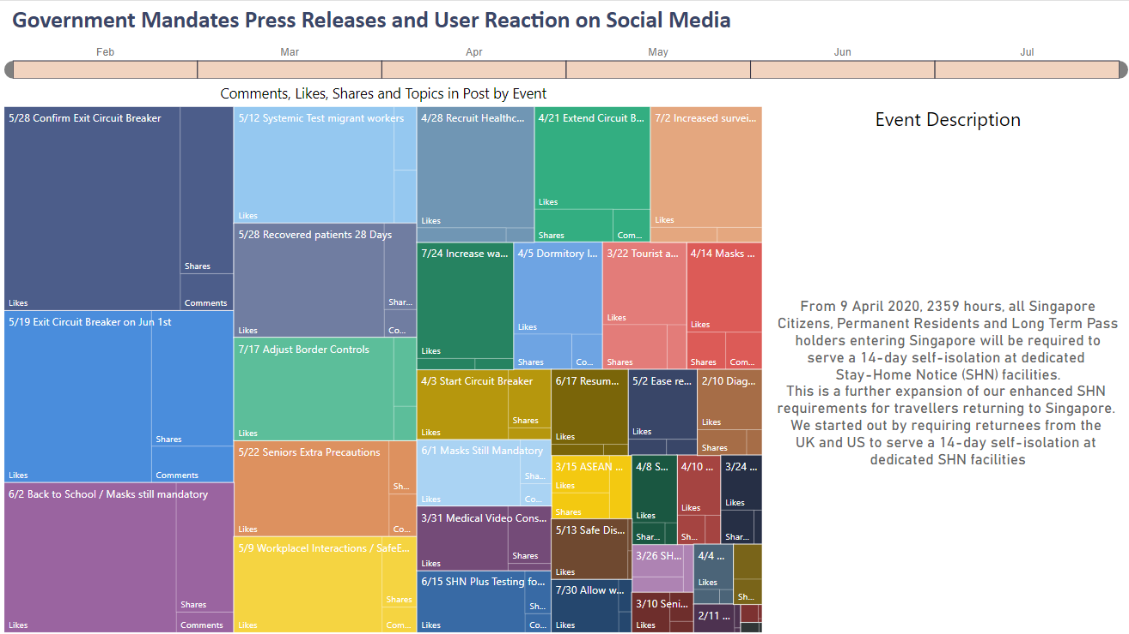

Slide 34
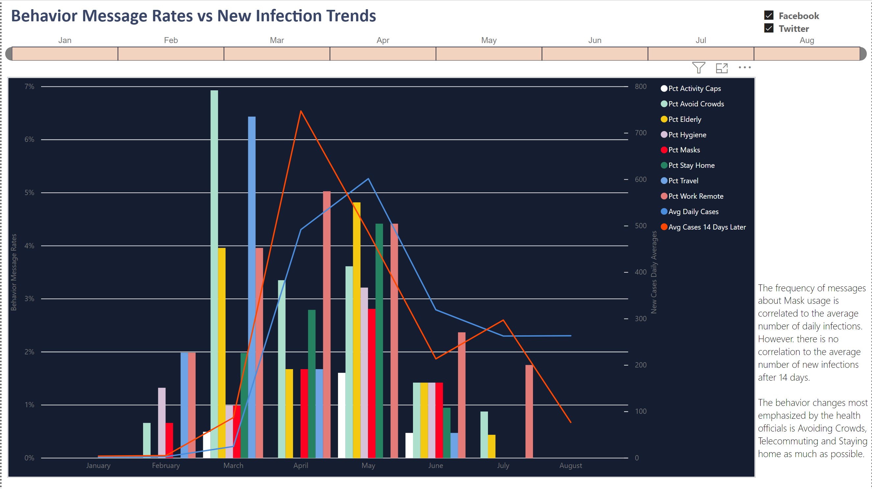

Slide 35
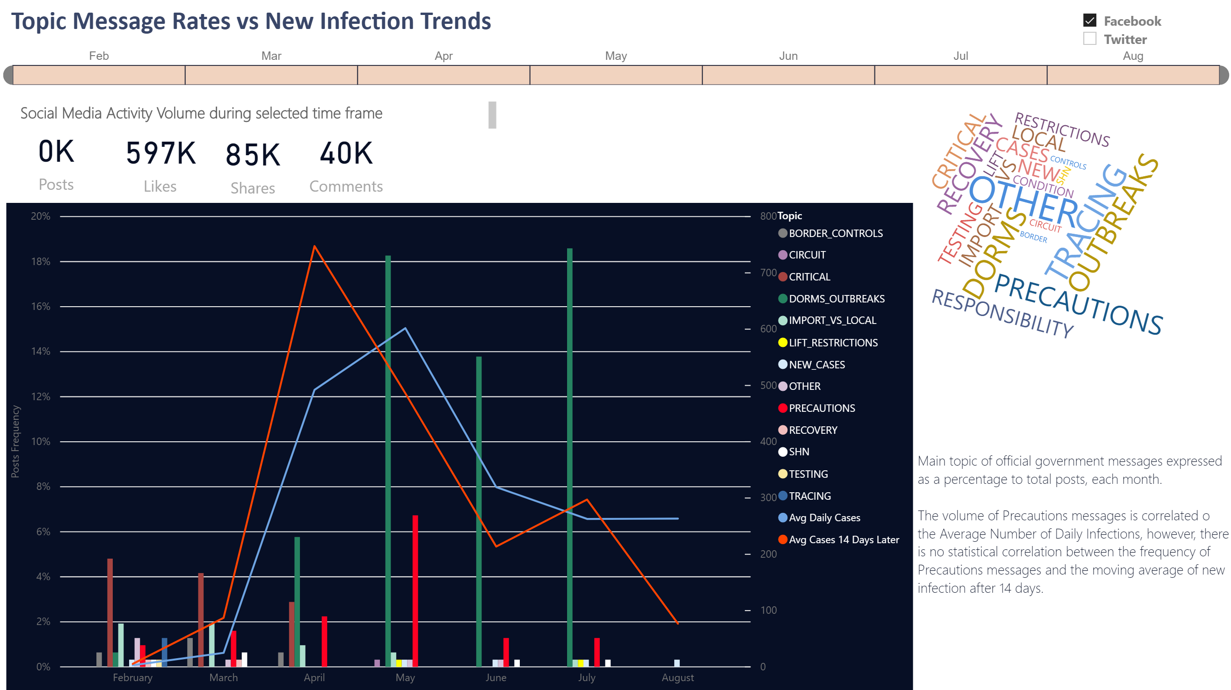

Slide 36
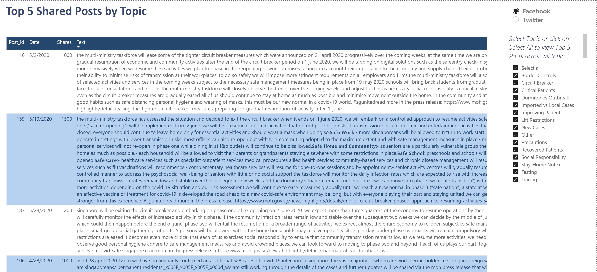

Slide 37
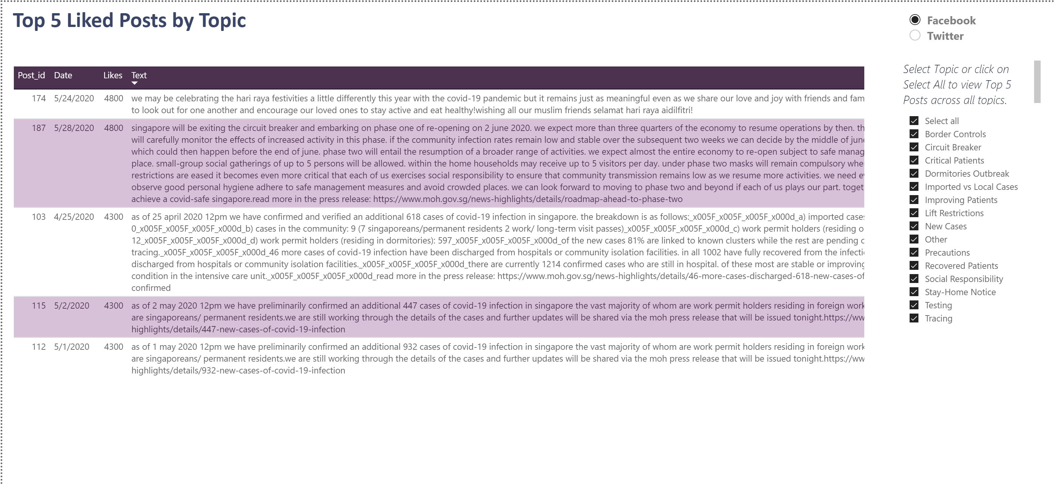

Slide 38
Final Deliverables
Research Report with findings on the relationship between the Social Media collected and new COVID-19 cases
Power BI Workbook with data and visualizations
SPSS Workbook(s) with data and statistical analysis results
All data files used in the analysis
All source code used to extract and prepare data for analysis in Excel

Slide 39

Thanks for watching our presentation!
Acknowledgements:
Dr. Shirley Tian
Dr. Meng Han

